Slide 2

Chapter Goals
To learn how to use the collection classes supplied in the Java library
To use iterators to traverse collections
To choose appropriate collections for solving programming problems
To study applications of stacks and queues

Slide 3
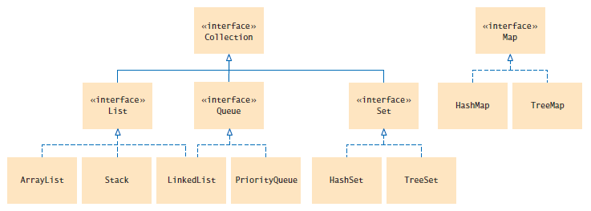
An Overview of the Collections Framework
A collection groups together elements and allows them to be retrieved later.
Java collections framework: a hierarchy of interface types and classes for collecting objects.
Each interface type is implemented by one or more classes
Figure 1 Interfaces and Classes in the Java Collections Framework

Slide 4
An Overview of the Collections Framework
The Collection interface is at the root
All Collection classes implement this interface
So all have a common set of methods

Slide 5

An Overview of the Collections Framework
List interface
A list is a collection that remembers the order of its elements.
Two implementing classes
ArrayList
LinkedList
Figure 2 A List of Books

Slide 6

An Overview of the Collections Framework
Set interface
A set is an unordered collection of unique elements.
Arranges its elements so that finding, adding, and removing elements is more efficient.
Two mechanisms to do this
hash tables
binary search trees
Figure 3 A Set of Books

Slide 7

An Overview of the Collections Framework
Stack
Remembers the order of elements
But you can only add and remove at the top
Figure 4 A Stack of Books

Slide 8

An Overview of the Collections Framework
Queue
Add items to one end (the tail) and remove them from the other end (the head)
A queue of People
A priority queue
an unordered collection
has an efficient operation for removing the element with the highest priority

Slide 9
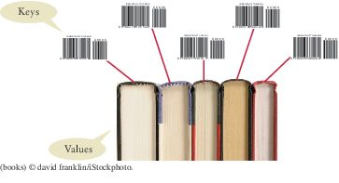
An Overview of the Collections Framework
Map
Keeps associations between key and value objects.
Every key in the map has an associated value.
The map stores the keys, values, and the associations between them.
Figure 5 A Map from Bar Codes to Books

Slide 10
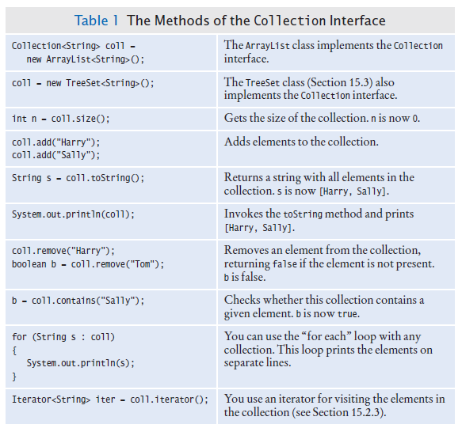
An Overview of the Collections Framework
Every class that implements the Collection interface has these methods.

Slide 11

Linked Lists
A data structure used for collecting a sequence of objects:
Allows efficient addition and removal of elements in the middle of the sequence.
A linked list consists of a number of nodes;
Each node has a reference to the next node.
A node is an object that stores an element and references to the neighboring nodes.
Each node in a linked list is connected to the neighboring nodes.

Slide 12

Linked Lists
Adding and removing elements in the middle of a linked list is efficient.
Visiting the elements of a linked list in sequential order is efficient.
Random access is not efficient.
Figure 6 Example of a linked list

Slide 13
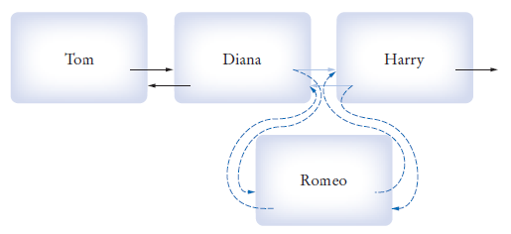
Linked Lists
When inserting or removing a node:
Only the neighboring node references need to be updated
Figure 7 Inserting a Node into a Linked List

Slide 14
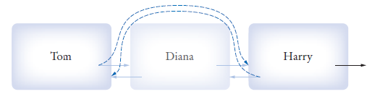
Linked Lists
Figure 8 Removing a Node From A Linked List
Visiting the elements of a linked list in sequential order is efficient.
Random access is not efficient.
When to use a linked list:
You are concerned about the efficiency of inserting or removing elements
You rarely need element access in random order

Slide 15
The LinkedList Class of the Java Collections Framework
Generic class
Specify type of elements in angle brackets: LinkedList<Product>
Package: java.util
LinkedList has the methods of the Collection interface.

Slide 16
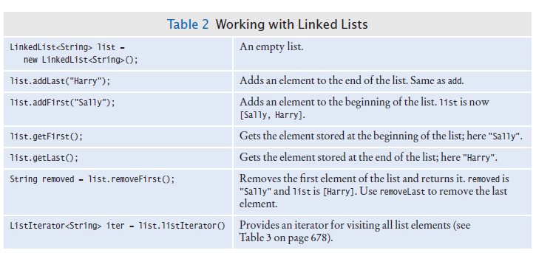
The LinkedList Class of the Java Collections Framework
Some additional LinkedList methods:

Slide 17
List Iterator
Use a list iterator to access elements inside a linked list.
Encapsulates a position anywhere inside the linked list.
Think of an iterator as pointing between two elements:
Analogy: like the cursor in a word processor points between two characters
To get a list iterator, use the listIterator method of the LinkedList class.
LinkedList<String> employeeNames = . . .;
ListIterator<String> iterator =
employeeNames.listIterator();
Also a generic type.

Slide 18
List Iterator
Initially points before the first element.
Move the position with next method:
if (iterator.hasNext())
{
iterator.next();
}
The next method returns the element that the iterator is passing.
The return type of the next method matches the list iterator's type parameter.

Slide 19
List Iterator
To traverse all elements in a linked list of strings:
while (iterator.hasNext())
{
String name = iterator.next();
Do something with name
}
To use the “for each” loop:
for (String name : employeeNames)
{
Do something with name
}

Slide 20
List Iterator
The nodes of the LinkedList class store two links:
One to the next element
One to the previous one
Called a doubly-linked list
To move the list position backwards, use:
hasPrevious
previous

Slide 21
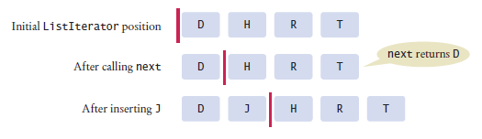
List Iterator
The add method adds an object after the iterator.
Then moves the iterator position past the new element.
iterator.add("Juliet");
Figure 8 A Conceptual View of the List Iterator

Slide 22
List Iterator
The remove method:
Removes object that was returned by the last call to next or previous
To remove all names that fulfill a certain condition:
while (iterator.hasNext())
{
String name = iterator.next();
if (condition is fulfilled for name)
iterator.remove();
}
Be careful when calling remove:
It can be called only once after calling next or previous
You cannot call it immediately after a call to add
If you call it improperly, it throws an IllegalStateException

Slide 23
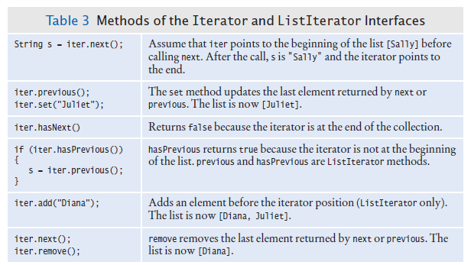
List Iterator
ListIterator interface extends Iterator interface.
Methods of the Iterator and ListIterator interfaces

Slide 24
Sample Program
ListDemo is a sample program that:
Inserts strings into a list
Iterates through the list, adding and removing elements
Prints the list

Slide 25
section_2/ListDemo.java
1 import java.util.LinkedList;
2 import java.util.ListIterator;
3
4 /**
5 This program demonstrates the LinkedList class.
6 */
7 public class ListDemo
8 {
9 public static void main(String[] args)
10 {
11 LinkedList<String> staff = new LinkedList<String>();
12 staff.addLast("Diana");
13 staff.addLast("Harry");
14 staff.addLast("Romeo");
15 staff.addLast("Tom");
16
17 // | in the comments indicates the iterator position
18
19 ListIterator<String> iterator = staff.listIterator(); // |DHRT
20 iterator.next(); // D|HRT
21 iterator.next(); // DH|RT
22
23 // Add more elements after second element
24
25 iterator.add("Juliet"); // DHJ|RT
26 iterator.add("Nina"); // DHJN|RT
27
28 iterator.next(); // DHJNR|T
29
30 // Remove last traversed element
31
Continued

Slide 26
section_2/ListDemo.java
32 iterator.remove(); // DHJN|T
33
34 // Print all elements
35
36 System.out.println(staff);
37 System.out.println("Expected: [Diana, Harry, Juliet, Nina, Tom]");
38 }
39 }
Program Run:
[Diana Harry Juliet Nina Tom]
Expected: [Diana Harry Juliet Nina Tom]

Slide 27
Sets
A set organizes its values in an order that is optimized for efficiency.
May not be the order in which you add elements.
Inserting and removing elements is more efficient with a set than with a list.

Slide 28
Sets
The Set interface has the same methods as the Collection interface.
A set does not admit duplicates.
Two implementing classes
HashSet
based on hash table
TreeSet
based on binary search tree
A Set implementation arranges the elements so that it can locate them quickly.

Slide 29
Sets
In a hash table
Set elements are grouped into smaller collections of elements that share the same characteristic.
Grouped by an integer hash code
Computed from the element
Elements in a hash table must implement the method hashCode. Must have a properly defined equals method.
You can form hash sets holding objects of type String, Integer, Double, Point, Rectangle, or Color.
HashSet<String>, HashSet<Rectangle>, or a HashSet<HashSet<Integer>>

Slide 30

Sets
On this shelf, books of the same color are grouped together. Similarly, in a hash table, objects with the same hash code are placed in the same group

Slide 31

Sets
In a TreeSet
Elements are kept in sorted order
Elements are stored in nodes.
The nodes are arranged in a tree shape,
Not in a linear sequence
You can form tree sets for any class that implements the Comparable interface:
Example: String or Integer.

Slide 32
Sets
Use a TreeSet if you want to visit the set's elements in sorted order.
Otherwise choose a HashSet
It is a bit more efficient — if the hash function is well chosen

Slide 33
Sets
Store the reference to a TreeSet or HashSet in a Set<String> variable:
Set<String> names = new HashSet<String>();
Or
Set<String> names = new TreeSet<String>();
After constructing the collection object:
The implementation no longer matters
Only the interface is important

Slide 34
Working with Sets
Adding and removing elements:
names.add("Romeo");
names.remove("Juliet");
Sets don't have duplicates.
Adding a duplicate is ignored.
Attempting to remove an element that isn't in the set is ignored.
The contains method tests whether an element is contained in the set:
if (names.contains("Juliet")) . . .
The contains method uses the equals method of the element type

Slide 35
Working with Sets
To process all elements in the set, get an iterator.
A set iterator visits the elements in the order in which the set implementation keeps them.
Iterator<String> iter = names.iterator();
while (iter.hasNext())
{
String name = iter.next();
Do something with name
}
You can also use the “for each” loop
for (String name : names)
{
Do something with name
}

Slide 36
Working with Sets
You cannot add an element to a set at an iterator position - A set is unordered.
You can remove an element at an iterator position.
The Iterator interface as no previous method.

Slide 37
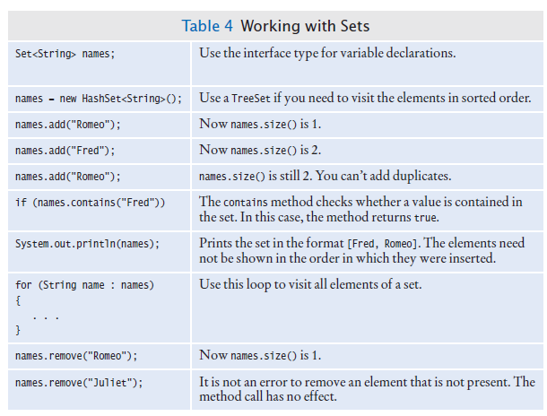
Working with Sets

Slide 38
SpellCheck Example Program
Read all the correctly spelled words from a dictionary file
Put them in a set
Reads all words from a document
Put them in a second set
Print all the words in the second set that are not in the dictionary set.
Potential misspellings

Slide 39
section_3/SpellCheck.java
1 import java.util.HashSet;
2 import java.util.Scanner;
3 import java.util.Set;
4 import java.io.File;
5 import java.io.FileNotFoundException;
6
7 /**
8 This program checks which words in a file are not present in a dictionary.
9 */
10 public class SpellCheck
11 {
12 public static void main(String[] args)
13 throws FileNotFoundException
14 {
15 // Read the dictionary and the document
16
17 Set<String> dictionaryWords = readWords("words");
18 Set<String> documentWords = readWords("alice30.txt");
19
20 // Print all words that are in the document but not the dictionary
21
22 for (String word : documentWords)
23 {
24 if (!dictionaryWords.contains(word))
25 {
26 System.out.println(word);
27 }
28 }
29 }
30
Continued

Slide 40
section_3/SpellCheck.java
31 /**
32 Reads all words from a file.
33 @param filename the name of the file
34 @return a set with all lowercased words in the file. Here, a
35 word is a sequence of upper- and lowercase letters.
36 */
37 public static Set<String> readWords(String filename)
38 throws FileNotFoundException
39 {
40 Set<String> words = new HashSet<String>();
41 Scanner in = new Scanner(new File(filename));
42 // Use any characters other than a-z or A-Z as delimiters
43 in.useDelimiter("[^a-zA-Z]+");
44 while (in.hasNext())
45 {
46 words.add(in.next().toLowerCase());
47 }
48 return words;
49 }
50 }
Program Run:
neighbouring
croqueted
pennyworth
dutchess
comfits
xii
dinn
clamour

Slide 41
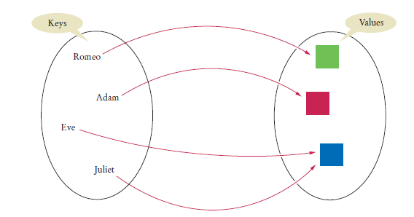
Maps
A map allows you to associate elements from a key set with elements from a value collection.
Use a map when you want to look up objects by using a key.
Figure 10 A Map

Slide 42
Maps
Two implementations of the Map interface:
HashMap
TreeMap
Store the reference to the map object in a Map reference:
Map<String, Color> favoriteColors =
new HashMap<String, Color>();

Slide 43
Maps
Use the put method to add an association:
favoriteColors.put("Juliet", Color.RED);
You can change the value of an existing association by calling put again:
favoriteColors.put("Juliet", Color.BLUE);
The get method returns the value associated with a key:
Color favorite = favorite.get("Juliet");
If you ask for a key that isn't associated with any values, the get method returns null.
To remove an association, call the remove method with the key:
favoriteColors.remove("Juliet");

Slide 44
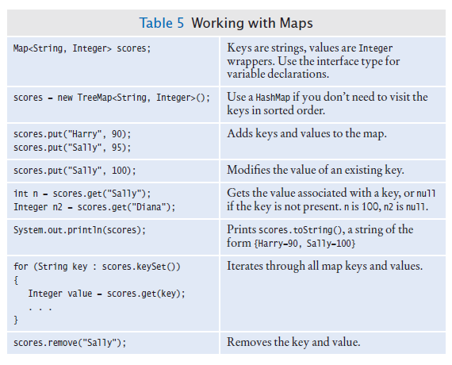
Working with Maps

Slide 45
Maps
Sometimes you want to enumerate all keys in a map.
The keySet method yields the set of keys.
Ask the key set for an iterator and get all keys.
For each key, you can find the associated value with the get method.
To print all key/value pairs in a map m:
Set<String> keySet = m.keySet();
for (String key : keySet)
{
Color value = m.get(key);
System.out.println(key + "->" + value);
}

Slide 46
section_4/MapDemo.java
1 import java.awt.Color;
2 import java.util.HashMap;
3 import java.util.Map;
4 import java.util.Set;
5
6 /**
7 This program demonstrates a map that maps names to colors.
8 */
9 public class MapDemo
10 {
11 public static void main(String[] args)
12 {
13 Map<String, Color> favoriteColors = new HashMap<String, Color>();
14 favoriteColors.put("Juliet", Color.BLUE);
15 favoriteColors.put("Romeo", Color.GREEN);
16 favoriteColors.put("Adam", Color.RED);
17 favoriteColors.put("Eve", Color.BLUE);
18
19 // Print all keys and values in the map
20
21 Set<String> keySet = favoriteColors.keySet();
22 for (String key : keySet)
23 {
24 Color value = favoriteColors.get(key);
25 System.out.println(key + " : " + value);
26 }
27 }
28 }
Continued

Slide 47
section_4/MapDemo.java
Program Run:
Juliet : java.awt.Color[r=0,g=0,b=255]
Adam : java.awt.Color[r=255,g=0,b=0]
Eve : java.awt.Color[r=0,g=0,b=255]
Romeo : java.awt.Color[r=0,g=255,b=0]

Slide 48
Choosing a Collection
Determine how you access the values.
Determine the element types or key/value types.
Determine whether element or key order matters.
For a collection, determine which operations must be efficient.
For hash sets and maps, decide whether you need to implement the hashCode and equals methods.
If you use a tree, decide whether to supply a comparator.

Slide 49
Hash Functions
You may need to implement a hash function for your own classes.
A hash function: a function that computes an integer value, the hash code, from an object in such a way that different objects are likely to yield different hash codes.
Object class has a hashCode method
you need to override it to use your class in a hash table
A collision: two or more objects have the same hash code.

Slide 50
Hash Functions
The method used by the String class to compute the hash code.
final int HASH_MULTIPLIER = 31;
int h = 0;
for (int i = 0; i < s.length(); i++)
{
h = HASH_MULTIPLIER * h + s.charAt(i);
}
This produces different hash codes for "tea" and "eat".

Slide 51

Hash Functions
A good hash function produces different hash values for each object so that they are scattered about in a hash table.

Slide 52
Hash Functions
Override hashCode methods in your own classes by combining the hash codes for the instance variables.
A hash function for our Country class:
public class Country
{
public int hashCode()
{
int h1 = name.hashCode();
int h2 = new Double(area).hashCode();
final int HASH_MULTIPLIER = 29;
int h = HASH_MULTIPLIER * h1 + h2;
return h;
}
}
A class's hashCode method must be compatible with its equals method.

Slide 53
Stacks
A stack lets you insert and remove elements only at one end:
Called the top of the stack.
Removes items in the opposite order than they were added
Last-in, first-out or LIFO order
Add and remove methods are called push and pop.

Slide 54

Stacks
Example
Stack<String> s = new Stack<String>();
s.push("A");
s.push("B");
s.push("C");
while (s.size() > 0)
{
System.out.print(s.pop() + " "); // Prints C B A
}
The last pancake that has been added to this stack will be the first one that is consumed.

Slide 55

Stacks
Many applications for stacks in computer science.
Consider: Undo function of a word processor
The issued commands are kept in a stack.
When you select “Undo”, the last command is popped off the stack and undone
Run-time stack that a processor or virtual machine:
Stores the values of variables in nested methods.
When a new method is called, its parameter variables and local variables are pushed onto a stack.
When the method exits, they are popped off again.

Slide 56
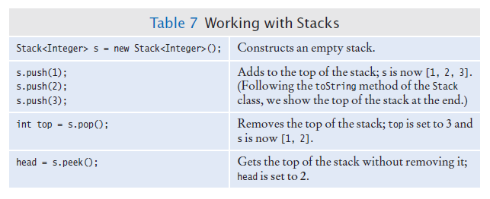
Stack in the Java Library
Stack class provides push, pop and peek methods.

Slide 57
Queue
A queue
Lets you add items to one end of the queue (the tail)
Remove items from the other end of the queue (the head)
Items are removed in the same order in which they were added
First-in, first-out or FIFO order
To visualize a queue, think of people lining up.
Typical application: a print queue.

Slide 58
Queue
The Queue interface in the standard Java library has: an add method to add an element to the tail of the queue,
A remove method to remove the head of the queue, and
A peek method to get the head element of the queue without removing it.
The LinkedList class implements the Queue interface. When you need a queue, initialize a Queue variable with a LinkedList object:
Queue<String> q = new LinkedList<String>();
q.add("A");
q.add("B");
q.add("C");
while (q.size() > 0) { System.out.print(q.remove() + " "); }
// Prints A B C

Slide 59
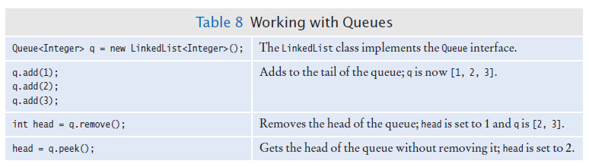
Queue

Slide 60

Priority Queue
A priority queue collects elements, each of which has a priority.
Example: a collection of work requests, some of which may be more urgent than others.
Does not maintain a first-in, first-out discipline.
Elements are retrieved according to their priority.
Priority 1 denotes the most urgent priority
Each removal extracts the minimum element
When you retrieve an item from a priority queue, you always get the most urgent one.

Slide 61
Priority Queue
Example: objects of a class WorkOrder into a priority queue.
PriorityQueue<WorkOrder> q =
new PriorityQueue<WorkOrder>();
q.add(new WorkOrder(3, "Shampoo carpets"));
q.add(new WorkOrder(1, "Fix broken sink"));
q.add(new WorkOrder(2, "Order cleaning supplies"));
When calling q.remove() for the first time, the work order with priority 1 is removed.
Elements should belong to a class that implements the Comparable interface.

Slide 62
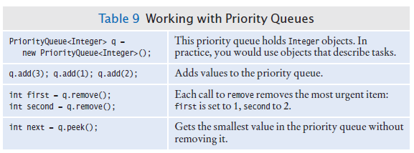
Priority Queue

Slide 63
Sorting and Searching in the Java Library - Sorting
You do not need to write sorting and searching algorithms
Use methods in the Arrays and Collections classes
The Arrays class contains static sort methods.
To sort an array of integers:
int[] a = . . . ;
Arrays.sort(a);
That sort method uses the Quicksort algorithm (see Special Topic 14.3).
To sort an ArrayList, use Collections.sort
ArrayList<String> names = . . .;
Collections.sort(names);
Uses merge sort algorithm

Slide 64
Stack and Queue Applications
A stack can be used to check whether parentheses in an expression are balanced.
When you see an opening parenthesis, push it on the stack.
When you see a closing parenthesis, pop the stack.
If the opening and closing parentheses don't match
The parentheses are unbalanced. Exit.
If at the end the stack is empty
The parentheses are balanced.
Else
The parentheses are not balanced.

Slide 65
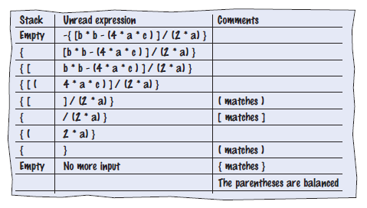
Stack and Queue Applications
Walkthrough of the sample expression:

Slide 66
Stack and Queue Applications
Use a stack to evaluate expressions in reverse Polish notation.
If you read a number
Push it on the stack.
Else if you read an operand
Pop two values off the stack.
Combine the values with the operand.
Push the result back onto the stack.
Else if there is no more input
Pop and display the result.

Slide 67
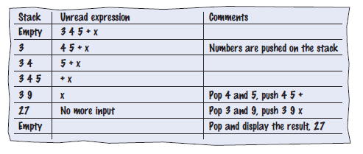
Stack and Queue Applications
Walkthrough of evaluating the expression 3 4 5 + ×:

Slide 68
section_6_2/Calculator.java
1 import java.util.Scanner;
2 import java.util.Stack;
3
4 /**
5 This calculator uses the reverse Polish notation.
6 */
7 public class Calculator
8 {
9 public static void main(String[] args)
10 {
11 Scanner in = new Scanner(System.in);
12 Stack<Integer> results = new Stack<Integer>();
13 System.out.println("Enter one number or operator per line, Q to quit. ");
14 boolean done = false;
15 while (!done)
16 {
17 String input = in.nextLine();
18
19 // If the command is an operator, pop the arguments and push the result
20
21 if (input.equals("+"))
22 {
23 results.push(results.pop() + results.pop());
24 }
25 else if (input.equals("-"))
26 {
27 Integer arg2 = results.pop();
28 results.push(results.pop() - arg2);
29 }
Continued

Slide 69
section_6_2/Calculator.java
30 else if (input.equals("*") || input.equals("x"))
31 {
32 results.push(results.pop() * results.pop());
33 }
34 else if (input.equals("/"))
35 {
36 Integer arg2 = results.pop();
37 results.push(results.pop() / arg2);
38 }
39 else if (input.equals("Q") || input.equals("q"))
40 {
41 done = true;
42 }
43 else
44 {
45 // Not an operator--push the input value
46
47 results.push(Integer.parseInt(input));
48 }
49 System.out.println(results);
50 }
51 }
52 }

Slide 70

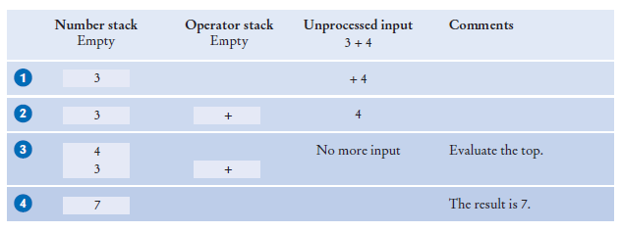
Evaluating Algebraic Expressions with Two Stacks
Using two stacks, you can evaluate expressions in standard algebraic notation.
One stack for numbers, one for operators
Evaluating the top: 3 + 4

Slide 71
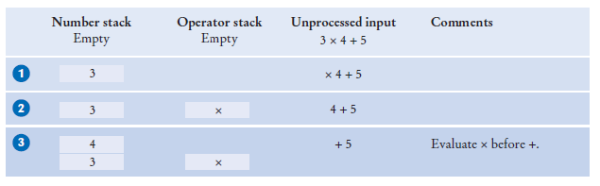
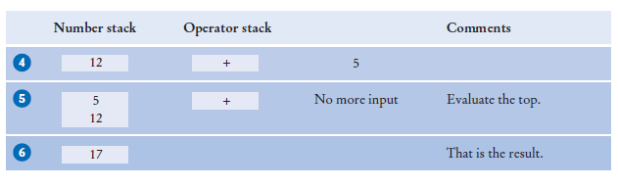
Evaluating Algebraic Expressions with Two Stacks
Evaluate 3 x 4 + 5
Push until you get to the +
x (top of operator stack) has higher precedence than + , so evaluate the top

Slide 72
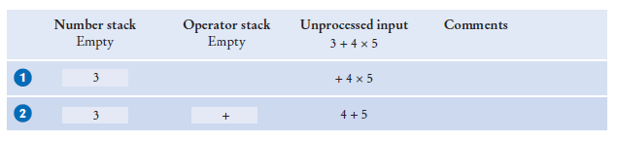
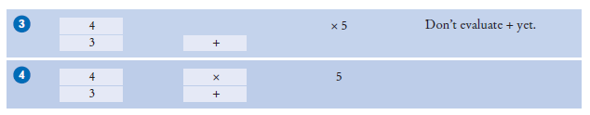
Evaluating Algebraic Expressions with Two Stacks
Evaluate 3 + 4 × 5
Add x to the operator stack so we can get the next number

Slide 73
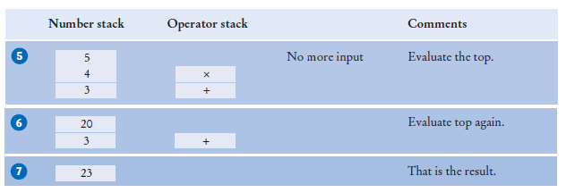
Evaluating Algebraic Expressions with Two Stacks
Keep operators on the stack until they are ready to be evaluated

Slide 74
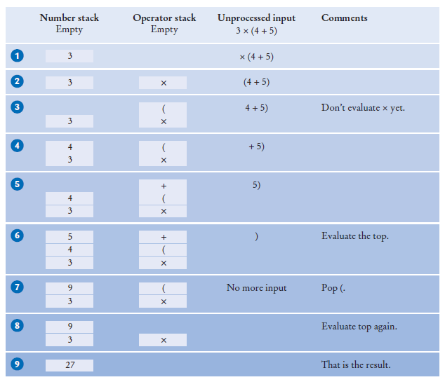
Evaluating Algebraic Expressions with Two Stacks
Evaluating parentheses: 3 × (4 + 5)
Push ( on the stack
Keep pushing until we reach the )
Evaluate until we find the matching (

Slide 75
Evaluating Algebraic Expressions with Two Stacks
The algorithm
If you read a number
Push it on the number stack.
Else if you read a (
Push it on the operator stack.
Else if you read an operator op
While the top of the stack has a higher precedence than op
Evaluate the top.
Push op on the operator stack.
Else if you read a )
While the top of the stack is not a (
Evaluate the top.
Pop the (.
Else if there is no more input
While the operator stack is not empty
Evaluate the top.
At the end, the value on the number stack the the value of the expression

Slide 76
Evaluating Algebraic Expressions with Two Stacks
Helper method to evaluate the top:
Pop two numbers off the number stack.
Pop an operator off the operator stack.
Combine the numbers with that operator.
Push the result on the number stack.

Slide 77
Backtracking
Use a stack to remember choices you haven't yet made so that you can backtrack to them.
Escaping a maze
You want to escape from a maze
You come to an intersection. What should you do?
Explore one of the paths
But remember the other paths.
If your chosen path doesn't work, you can
go back and try one of the other choices
Use a stack to remember the paths that still need to be tried.
The process of returning to a choice point and trying another choice is called backtracking.

Slide 78
Backtracking – Maze Example
Start, at position (3, 4).
There are four possible paths. We push them all on a stack .
We pop off the topmost one, traveling north from (3, 4).
Following this path leads to position (1, 4).
We now push two choices on the stack, going west or east .
Both of them lead to dead ends .
Now we pop off the path from (3,4) going east.
That too is a dead end .
Next is the path from (3, 4) going south.
Comes to an intersection at (5, 4).
Both choices are pushed on the stack .
They both lead to dead ends .
Finally, the path from (3, 4) going west leads to an exit .

Slide 79
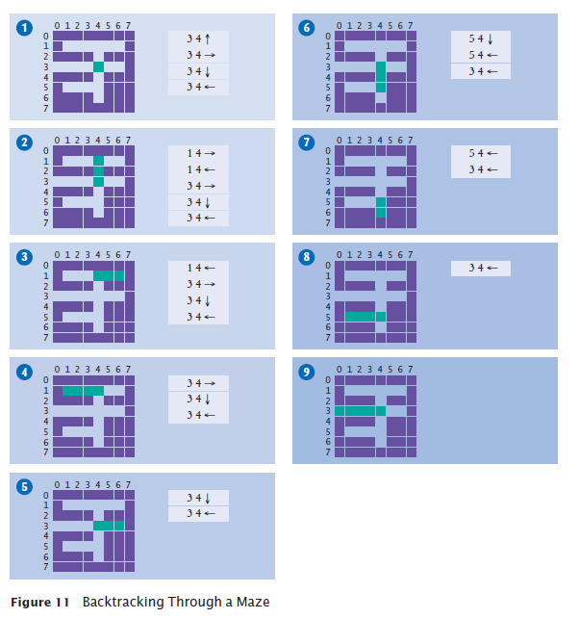
Backtracking – Maze Example

Slide 80
Backtracking – Maze Example
Algorithm:
Push all paths from the point on which you are standing on a stack.
While the stack is not empty
Pop a path from the stack.
Follow the path until you reach an exit, intersection, or dead end.
If you found an exit
Congratulations!
Else if you found an intersection
Push all paths meeting at the intersection, except the current one, onto the stack.
This works if there are no cycles in the maze.
You never circle back to a previously visited intersection
You could use a queue instead of a stack.

Slide 81
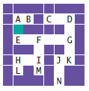
Self Check 15.30
Consider the following simple maze. Assuming that we start at the marked point and push paths in the order West, South, East, North, in which order are the lettered points visited, using the algorithm of Section 15.6.4?

Slide 82
Self Check 15.30
Consider the following simple maze. Assuming that we start at the marked point and push paths in the order West, South, East, North, in which order are the lettered points visited, using the algorithm of Section 15.6.4?
Answer: A B E F G D C K J N

